Slide 1


CAPSTONE PROJECT
Project Title: E-Commerce Sales Analysis using Power BI
Presented By
Student Name: Karthikeya Satya Sai Pavan Challapalli
College Name: annabhathuni Satyanarayana Degree College
Department: BSc Computer Science
Email ID: karthikchallapalli666@gmail.com

Slide 2
OUTLINE:
Problem Statement
Proposed System/Solution
System Development Approach
Algorithm & Deployment
Result
Conclusion
Future Scope
References

Slide 3
Problem Statement:
In today’s competitive e-commerce environment, businesses generate a large amount of sales and customer data every day. However, many organizations struggle to analyze this data effectively and extract meaningful insights that can support better business decisions. Raw data stored in spreadsheets or databases is often complex and difficult to interpret without proper visualization tools.
The main problem is the lack of an interactive and centralized system that allows stakeholders to quickly understand key metrics such as sales performance, product demand, regional sales distribution, and customer purchasing behavior.
To address this issue, a Power BI–based interactive dashboard is developed. The system integrates sales data and transforms it into meaningful visualizations such as charts, graphs, and KPIs. This enables business managers to monitor performance, identify trends, track top-performing products, and make data-driven decisions efficiently.
The goal of this project is to design a dynamic and user-friendly Power BI dashboard that provides real-time insights into e-commerce sales performance and supports strategic planning.

Slide 4
Proposed Solution:
The proposed system aims to develop an interactive Power BI dashboard that analyzes e-commerce sales data and provides meaningful business insights. The dashboard helps users easily monitor sales performance, identify trends, and compare product categories and regions.
The system consists of the following components:
Data Collection: The dataset containing e-commerce sales information such as product category, sales amount, profit, region, and monthly sales trends is collected and imported into Power BI.
Data Processing: The dataset is cleaned and organized to ensure accuracy and consistency. Relevant fields such as sales, profit, product category, and region are used for analysis.
Data Visualization: Power BI visualizations are created to represent key business metrics including:
Total Sales
Total Profit
Total Products Sold
Sales by Category
Interactive Dashboard: Interactive filters such as Region Filter and Category Filter allow users to dynamically explore the data and gain deeper insights into business performance.

Slide 5
System Approach:
System Approach
The system approach describes the process used to develop the E-Commerce Sales Analysis Dashboard using Power BI.
System Requirements
Software: Power BI Desktop
Dataset: E-commerce sales dataset (CSV format)
Operating System: Windows 10/11
Tools and Technologies
Power BI Desktop for data analysis and visualization
Data cleaning and transformation using Power BI tools
Development Process
Import the e-commerce sales dataset into Power BI.
Clean and organize the data for analysis.
Create key metrics such as Total Sales, Total Profit, and Total Products Sold.
Build visualizations including bar charts, line charts, and pie charts.
Add interactive filters for Region and Category to explore data dynamically.

Slide 6
Algorithm & Deployment:
Algorithm / Process Used
Data Input
E-commerce sales dataset containing product category, sales amount, profit, region, and month.
Data Processing
Data is imported into Power BI and cleaned to remove inconsistencies.
Relevant fields such as sales, profit, category, and region are selected for analysis.
Visualization Process
Key performance indicators (KPIs) such as Total Sales, Total Profit, and Total Products Sold are created.
Charts including bar charts, line charts, and pie charts are used to visualize trends and comparisons.
Dashboard Deployment
All visualizations are combined into an interactive Power BI dashboard.
Filters for Region and Category allow users to explore the data dynamically.

Slide 7
Result:
The developed Power BI dashboard successfully visualizes e-commerce sales data and provides meaningful insights into business performance.
Key Outcomes
The dashboard displays important KPIs such as Total Sales, Total Profit, and Total Products Sold.
Sales performance is analyzed using Sales by Category, helping identify which product category generates the most revenue.
The Monthly Sales Trend chart shows how sales vary across different months.
Regional Sales Distribution provides insights into sales performance across different regions.
The Top Products by Sales chart highlights the best-performing products.
Interactive Analysis
Users can apply Region Filter and Category Filter to dynamically explore the data and gain deeper insights.
The dashboard enables businesses to monitor sales performance, identify trends, and support data-driven decision making.

Slide 8
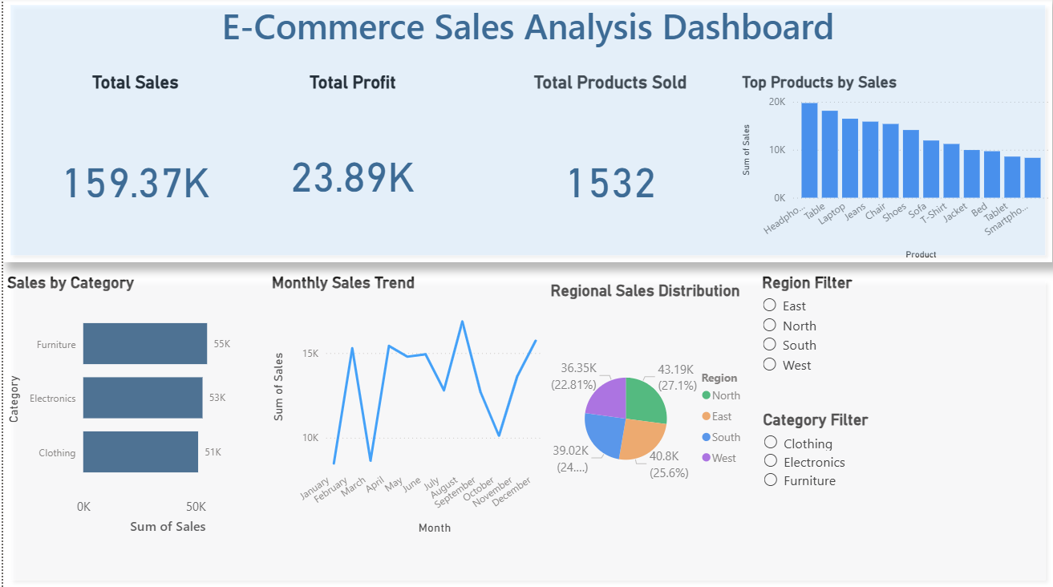

Slide 9
Conclusion:
The E-Commerce Sales Analysis Dashboard developed using Power BI effectively converts complex raw sales data into clear and meaningful visual insights. By integrating various data visualization techniques such as charts, graphs, and KPIs, the dashboard provides a comprehensive overview of business performance. Key metrics including Total Sales, Total Profit, Product Category Performance, Monthly Sales Trends, and Regional Sales Distribution help users quickly understand important business patterns.
The interactive features of the dashboard, such as region and category filters, allow users to dynamically explore the data and gain deeper insights. This enables businesses to easily identify top-performing products, seasonal sales patterns, and regional demand differences.
Overall, the project demonstrates how Power BI can be used as a powerful business intelligence tool to analyze large datasets, simplify complex information, and support data-driven decision making. The developed dashboard helps organizations monitor performance more efficiently and provides valuable insights that can improve strategic planning and business growth.

Slide 10
Future scope:
The dashboard can be enhanced by integrating real-time sales data from live business systems.
Additional datasets such as customer demographics, marketing campaigns, and seasonal trends can be incorporated for deeper analysis.
Advanced analytics techniques such as predictive sales forecasting can be implemented to estimate future sales trends.
The dashboard can be expanded to analyze multiple regions, cities, or international markets.
Integration with cloud platforms and automated data refresh can improve accessibility and scalability.

Slide 11
References:
Microsoft Power BI Documentation – https://powerbi.microsoft.com
Ferrari, A., & Russo, M. (2016). Introducing Microsoft Power BI. Microsoft Press.
Powell, B. (2017). Microsoft Power BI Cookbook. Packt Publishing.
Tirupati, K., Joshi, A., & Singh, S. (2023). Leveraging Power BI for Enhanced Data Visualization and Business Intelligence.
Gonçalves, C. (2023). Developing Integrated Performance Dashboards using Power BI.
GitHub Link: https://github.com/Karthik6-cpu/powerbi-ecommerce-dashboard.git

Slide 12
Thank You

